Slide 1
Introduction to Security Within the Organization
GRC Day 1

Slide 2

Class Objectives
By the end of today’s class, you will be able to:
Identify at least three concrete benefits of a healthy security culture.
Articulate the responsibilities of common C-Suite officers, including the CISO.
Explain the responsibilities of a Security department.
Identify appropriate security controls for a given resource and situation.

Slide 3
Security Aligning with an Organization

Slide 4

Throughout this course, you will be equipped with the tools needed to perform in common technical roles.
Today, we will see how these roles interact with each other and within the larger organization.
Notes:
Image source: Dragonlady

Slide 5



GRC Framework
GRC is a framework for answering the questions: What assets are most important? and What is adequate protection?
Governance: Creating management processes for implementing security practices across the organization.
Compliance: Making sure the business follows internal security policies and adheres to relevant security laws.
Risk management: Identifying an organization’s most important assets and determining how they might be compromised.
We define “important” by asking: How would a security compromise of this asset affect
the profits of the business?
The more significant the loss, the more important the asset.
Notes:
Image source: shutterstock_751015789

Slide 6

GRC Framework
We will study how GRC frameworks are considered and implemented into a business by first examining the following:
The Executive Management team
is ultimately responsible for the adherence and enforcement of laws, regulations, and security practices.
The Security team
and the role it plays within the larger organization.
Notes:
shutterstock_206873725

Slide 7
Security Roles and Responsibilities
In the next section, we’ll cover the following:
The responsibilities of Security departments.
The structure of the security organization.
Executive roles existing in most companies.
Executive roles relevant to Security departments.

Slide 8
Executive Roles: The Core Leadership Team
Chief Executive Officer
(CEO)
Chief Financial Officer
(CFO)
Chief Operating Officer
(COO)
Chief Information Security Officer
(CISO)
Chief Information Officer
(CIO)
The Chief Executive Officer (CEO) is responsible for plotting the overall direction of the company. The CEO reports to the board of directors. This group is elected by shareholders and holds the CEO accountable for meeting their demands.

Slide 9
Executive Roles: The Core Leadership Teams
CEO
CFO
COO
CISO
CIO
Chief Financial Officer
Charts and monitors the company's financial trajectory, helping ensure the company uses its finances wisely.
Chief Operating Officer
Ensures a business is able to function effectively day-to-day. Typically reports directly to the CEO.
Chief Information Security Officer (CISO)
Manages risk to an organization’s data throughout its lifecycle.
Chief Information Officer (CIO)
Develops IT systems that support the business. Typically reports to the CEO.

Slide 10
The Responsibilities of the Security Department
CISO is responsible for protecting the company’s data, often overseeing the following teams, among others:
Network Security
Incident Response
Application Security
Director of networking or director of network security is in charge of networks.
IR manager or SOC manager manages and Incident Response unit.
Security architect is in charge of application security.
A director of networking often has system administrators, network administrators, and physical network technicians on staff. They may also manage a help desk.
An SOC manager employs SOC analysts, also known as security analysts or incident handlers.
A security architect typically manages security engineers and software engineers.
Notes:
Network Security: secures networks and implements network security policies. This group also manages services like the corporate VPN, etc.
Incident Response: identifies and responds to security breaches. IR is responsible for SOCs, which monitor the organization's devices for incidents. They are also responsible for escalating serious breaches to the executive team for handling.
Application Security: ensures any software or web applications developed in-house is secure. This prevents such disasters as insecure internal messaging apps that leak confidential information, etc.

Slide 11

Security and the Larger Organization
Security operations will interact with other non-security teams within the organization.
For example: An organization’s Marketing and Communications teams use the networks and accounts that IT and Networking manage.
What other examples can you think of?
Notes:
Image source: Morgan Thomas

Slide 12

Security Concerns vs. Business Concerns
The most profitable decision isn’t always the most secure. Security objectives may be at odds with those of the business.
Security Team’s Main Goal:
Protect the business’s data.
Business’s Main Goal:
Maximize profit and improve efficiency.
Notes:
Image sources: shutterstock_1031110966 (security); shutterstock_79207660 (business)

Slide 13

What Should the Security Team Do?
CASE STUDY
An organization’s Engineering team proposes an innovative but insecure new feature for their flagship product.
Security Team:
Would probably advise against the new feature due to its poor security.
Business-At-Large:
Might decide to develop it anyway, believing the potential profit is worth the risk.
Notes:
Image source: shutterstock_1505649707

Slide 14
What Should the Security Team Do?
CASE STUDY
The Security team must adapt its operations to accomModate a product they know is insecure.
Potential Solutions:
Put in place more aggressive monitoring on data servers likely to be exposed by the new feature.
Advise IT and Networking to put in place more sophisticated access controls on important servers and proxies.

Slide 15

100% security is not the business’s goal.
To limit spending and increase profit, businesses often provide only adequate protection for their most important assets.
Notes:
Image source: Joseph Allen Kohlhas

Slide 16
Security vs. Business:
Is the Feature Worth the Risk?
CASE STUDY
An organization’s Engineering team proposes an innovative but insecure new feature for their flagship product.
The organization performs a risk assessment and concludes that the feature could lead to a 25% increase in quarterly profits. The feature would also risk exposing an isolated data server containing customer names, usernames, and email addresses, but no other PII (personally identifiable information).

Slide 17
Security vs. Business:
Is the Feature Worth the Risk?
CASE STUDY
In this case, the business objective of achieving profit targets overrides the risk of the strategy.
Business Wins
The Security team objects to the feature due to its insecurity. But the business decides that the cost of the potential breach—of an isolated server with no sensitive PII—would be less than the potential profit of the feature.

Slide 18

After making a decision, the business updates its security practices to account for the risk they’ve undertaken, and regularly confirms everyone is following the rules.
This is governance and compliance.
Notes:
Image source: shutterstock_741647569

Slide 19
Activity: Weighing Security and Business Objectives
In this activity, you’ll play the role of a security consultant hired to help a business determine how risky its plans are.
10 Minutes

Slide 21
Security Culture Framework

Slide 22

Security Culture
Strong organizational security begins with making sure employees both consider security important and understand the security implications of their decisions.
Security culture is the way members of an organization think about and approach security issues. A healthy security culture has employees who are invested in the organization’s security and “behave securely.”
The health of an organization’s security culture is determined by:
How important employees consider security.
How aware employees are of common security risks.
Whether employees know how to avoid insecure behavior.
Notes:
Image source: Iurii Bairamukov

Slide 23

A healthy security culture requires motivating employees to value security, and training them on how to avoid insecure behavior.

Slide 24
Security Culture Framework Steps
The security culture framework identifies problems in an organization’s security culture and develops plans to solve them.
01
Measure and Set Goals
02
Involve the Right People
03
Create an Action Plan
04
Execute the Plan
05
Measure Change

Slide 25

Applying the Framework: Security Scenario
Employees are clicking on links and downloading attachments in these emails.
The organization’s Security team determined that many of the links and attachments contain malware.
Employees are receiving emails to their work accounts from external sources.
Notes:
Image source: AdobeStock_231959365

Slide 26
Step 1: Measure and Set Goals
Hire a pentester to run a phishing campaign against your organization. They will send malicious files to everyone in the organization and keep track of who downloads them.
05
Measure Changes
Measure and Set Goals Set a click rate goal of 5%. Measure this data to determine (1) what percentage of employees download the files and (2) which employees download them.
01
04
Execute the Plan
Involve the Right People
02
03
Create an Action Plan
Notes:
Suppose that 9% of employees download the malicious files. Based on these findings, set a goal that only 5% of employees download malicious files by the start of the next fiscal year.
In addition to this end goal, aim to train 25% of employees every quarter, until you've trained everyone by the end of the year.

Slide 27
Step 2: Involve the Right People
Since this training will affect all members of the organization, inform the Executive team about the problem and your decision to implement training.
05
Measure Changes
Measure and Set Goals Measure how employees interact with the campaign, determining the percentage of employees who download the files and who they are. Set goals based on this data.
01
04
Execute the Plan
Involve the Right People Inform at least the CEO and/or CIO, director of HR, and the person in charge of internal training and communication.
02
03
Create an Action Plan
Notes:
In addition, perhaps to draft a contract with the pentesting team that ran the original phishing campaign to ensure that they can run the same test next year to provide reliable measurements as to how effective the training has been.

Slide 28
Step 3: Create an Action Plan
After getting clearance to run the training, plan to deliver an annual Cybersecurity Awareness Training event.
05
Measure Changes
Measure and Set Goals Measure how employees interact with the campaign, determining the percentage of employees who download the files and who they are. Set goals based on this data.
01
04
Execute the Plan
Involve the Right People Inform at least the CEO and/or CIO, director of HR, and the person in charge of internal training and communication.
02
03
Create an Action Plan
Develop training to cover dangers of malware and how malware can spread through phishing and vishing.
Notes:
Create an Action Plan: After getting clearance to run the training, plan to deliver an annual Cybersecurity Awareness Training event that teaches employees about:
The Dangers of Malware
How Malware Spreads through Phishing
How Malware Spreads through Vishing
How to Avoid Phishing and Vishing Attacks

Slide 29
Step 4: Execute the Plan
After developing the training, run it with the goal of training 25% of employees every quarter.
05
Measure Changes
Measure and Set Goals Measure how employees interact with the campaign, determining the percentage of employees who download the files and who they are. Set goals based on this data.
01
04
Execute the Plan
Run training with a goal of training 25% of employees each quarter.
Involve the Right People Inform at least the CEO and/or CIO, director of HR, and the person in charge of internal training and communication.
02
03
Create an Action Plan
Develop training to cover dangers of malware and how malware can spread through phishing and vishing.

Slide 30
Step 5: Measure Change
After training the entire company, have the pentesters rerun the original phishing campaign.
05
Measure Changes
Determine success or failure based on goals set in Step 1.
Measure and Set Goals Measure how employees interact with the campaign, determining the percentage of employees who download the files and who they are. Set goals based on this data.
01
04
Execute the Plan
Run training with a goal of training 25% of employees each quarter.
Involve the Right People Inform at least the CEO and/or CIO, director of HR, and the person in charge of internal training and communication.
02
03
Create an Action Plan
Develop training to cover dangers of malware and how malware can spread through phishing and vishing.
Notes:
You might find that only 6% of employees download malicious files.
In this case, you observed a roughly 30% reduction in malicious file downloads, but didn't quite meet the initial goal.
At this point, you would either revise that target, or run the training again until you get below 5%.

Slide 31
Activity: Applying the Security Culture Framework: Part 1
You'll play the role of a security consultant contracted by a local bank to develop a plan for strengthening physical security.
15 minutes

Slide 33
33
Notes:
Image source: AdobeStock_56885471

Slide 34
Security Culture Framework: Action Plan

Slide 35
Back to Our Security Scenario...
Employees are clicking on links and downloading attachments in these emails.
The organization’s Security team determined that many of the links and attachments contain malware.
Employees are receiving emails to their work accounts from external sources.
Let’s walk through the steps again, with the added context of coordinating with other team members.
Notes:
Image source: AdobeStock_231959365

Slide 36
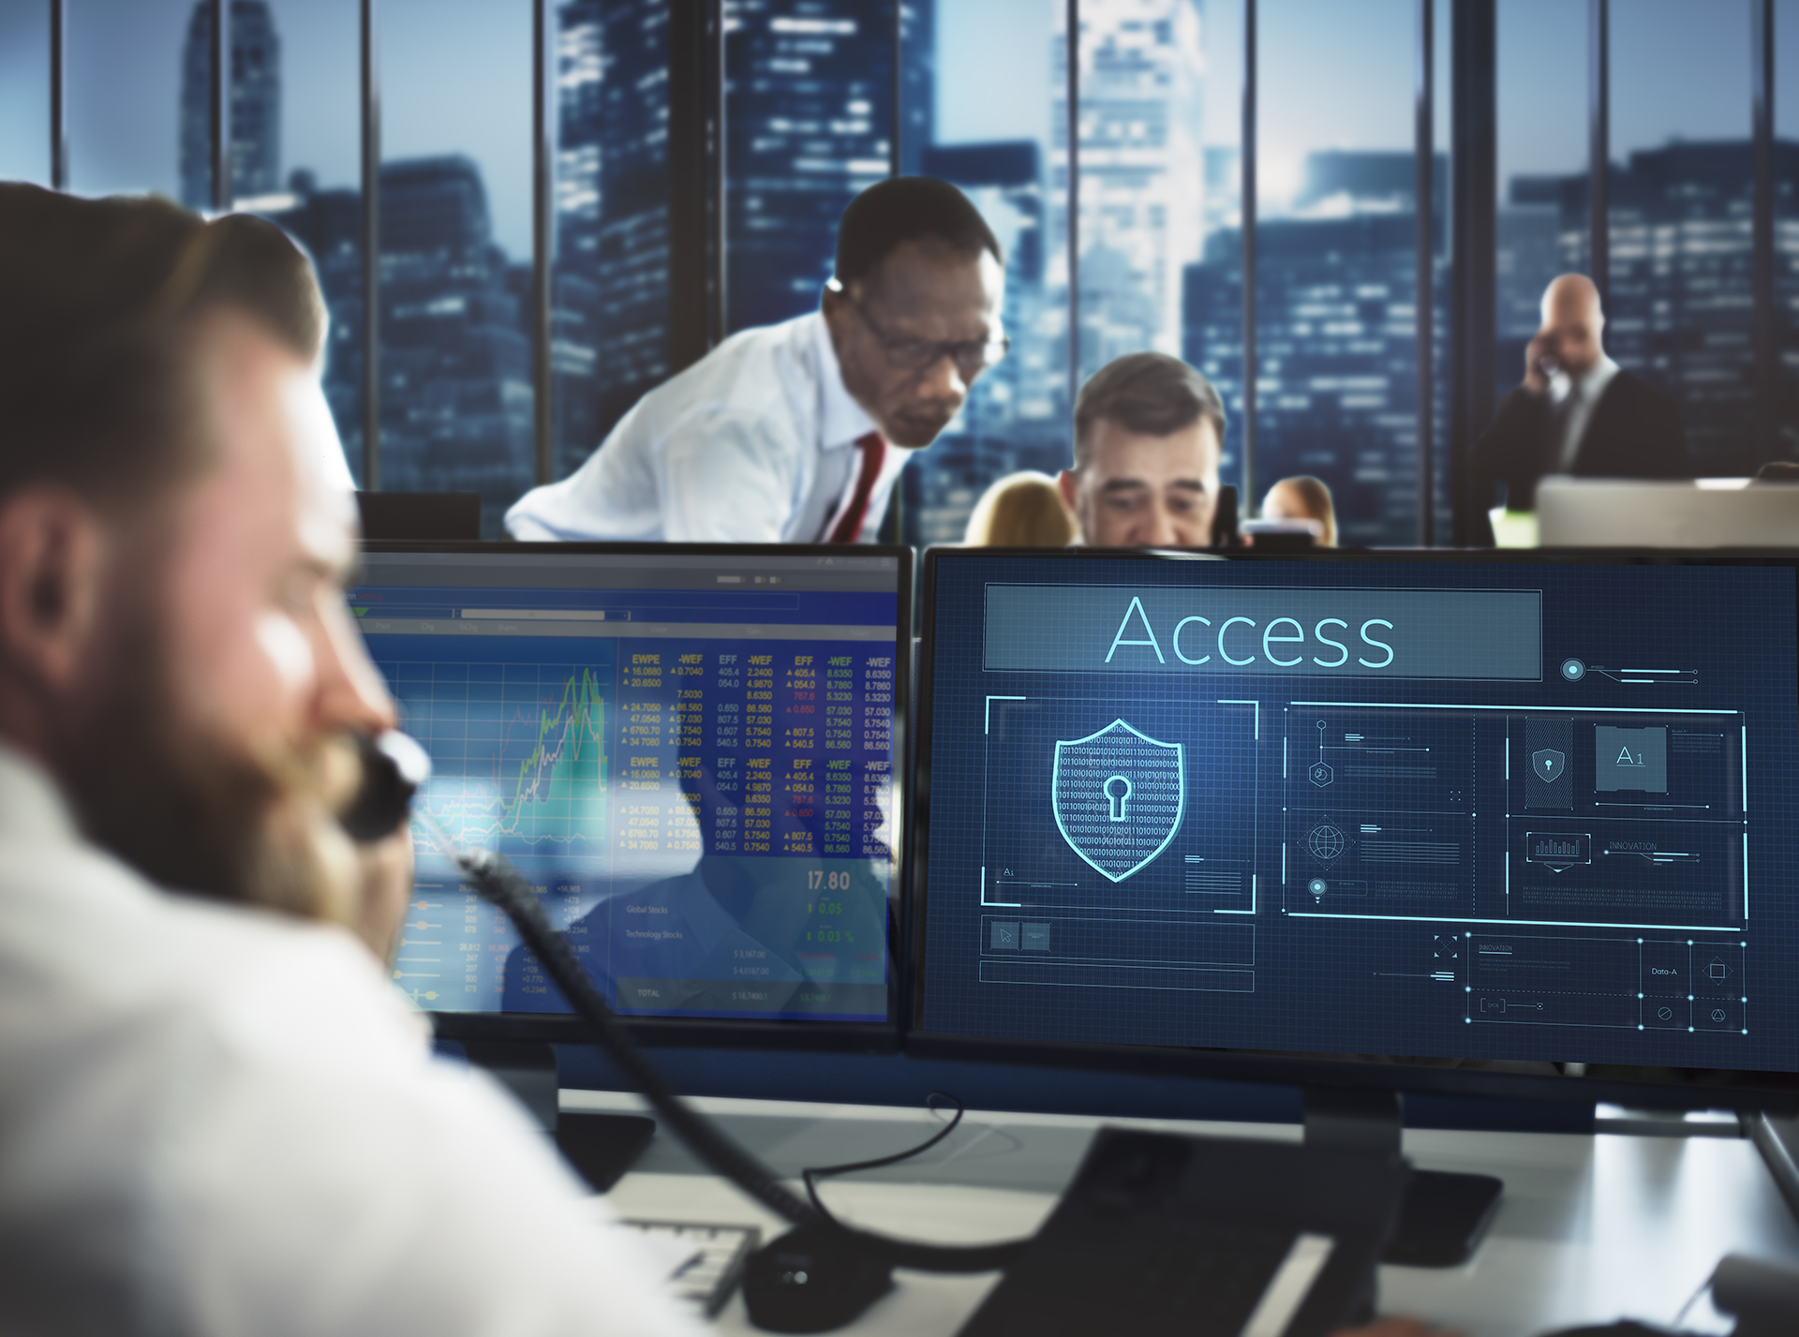
Security Culture Framework Steps
Step 1: The Security Culture Framework (SCF) team meets to assess the impact of the phishing incident and the risk posed by future campaigns. This discussion includes:
An assessment of the damage done by the previous phishing incident.
Using a pentesting phishing attack to show how many employees download malicious files. This assessment might find a 10% click-through rate, meaning that 10% of employees downloaded malicious email attachments.
Setting a target click-through rate. The team might decide that a 5% click-through rate is acceptable.
Notes:
Image source: shutterstock_605029655

Slide 37

Security Culture Framework Steps
Step 2: The SCF team manager (in this case, the IR manager) meets with the CISO to explain that the previous phishing attack was successful because 10% of employees downloaded files from unknown email addresses.They request a budget to carry out a plan that will bring this number down to 5%, and explain how it will profit the business.
Notes:
Image source: shutterstock_562442005

Slide 38

Security Culture Framework Steps
Step 3: The SCF team develops a training plan to educate employees.
In addition, the SCF team develops a Supplemental Security Awareness training plan. This plan will only be delivered to employees who continue to click malicious links after training.
Notes:
Image source: shutterstock_1160496028

Slide 39

Security Culture Framework Steps
Step 4: After developing the training, the SCF team decides on incentives and disincentives. These will be awarded based on how employees behave during penetration tests and security audits.
Since employees won't know exactly when the assessments are being conducted, the team expects more people to follow the new download guidelines.
Incentives for not clicking:
Disincentives for clicking:
A $40 gift card, free or discounted security conference attendance, and additional vacation time.
Supplemental security awareness training and additional random device audits for one quarter.
Notes:
shutterstock_451052407

Slide 40

Security Culture Framework Steps
Step 5: The SCF team collaborates with HR to determine the best dates to run trainings.
During these meetings, the HR team explains that the most reliable way to ensure 100% attendance over the next fiscal year is to have quarterly training sessions, training 25% of employees each time.
SCF and HR coordinate the specific dates and location of the training.
Notes:
shutterstock_717248242

Slide 41

Security Culture Framework Steps
Step 6: The SCF team collaborates with Communications to develop and distribute information about the training.
Step 7: The SCF team sets up and runs the training as scheduled.

Slide 42

Security Culture Framework Steps
Step 8: Every quarter, the SCF team contracts the same pentesting firm to run the phishing campaign against all employees who have already been trained.
Step 9: After every test, the SCF team identifies employees who still clicked malicious links, and requires them to go through Supplemental Security Awareness training.
In addition, they verify whether the click-through rate drops closer to 5%.
Notes:
shutterstock_1174726795

Slide 43

Security Culture Framework Steps
Step 10: After training the entire company, the SCF team runs a final phishing campaign to evaluate the overall effectiveness of the training.
If they find that the click-through rate (CTR) is 5% or lower, it is considered a success.
Otherwise, they might decide to run the training for an additional year, or take a different approach to solving the problem.
Notes:
shutterstock_525253807

Slide 44
What’s the (Action) Plan?
Some important considerations when developing a plan:
When will you measure progress?
How will you quantify progress?
When will the plan be executed?
Notes:
Discuss as a class before reviewing in the next slide.

Slide 45

What’s the (Action) Plan?
Questions you should ask when developing a plan:
When will the plan be executed? The SCF and HR teams will run the training once every quarter, training 25% of employees each time. This ensures 100% of employees will be trained by the end of the year.
When will you measure progress? The SCF team will run a phishing campaign each quarter, targeting only the most recently trained cohort. After all cohorts have been trained, a final campaign will test how well everyone follows the new guidelines over time.
How will you quantify progress?
The SCF team decides to quantify the click-through rate, which is the percentage of employees who download malicious links from emails. Their goal is to decrease this number from 10% to 5%.
Notes:
Image source: VideoZee Studio

Slide 46
Activity: Security Culture Framework: Part 2
In this activity, you will complete the plan you began drafting in Part 1 earlier today.
20 Minutes

Slide 48
Security Controls

Slide 49
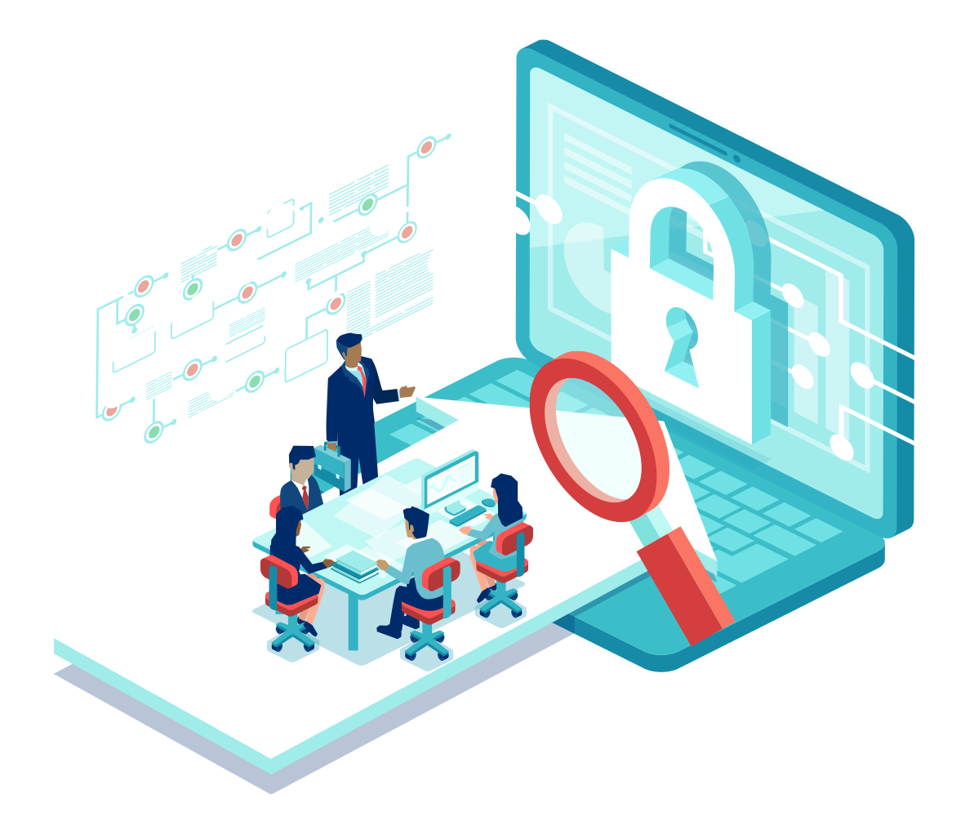
In addition to improving security culture over the long term, the security team should enforce security controls that manage issues in the short term.
Notes:
Image source: shutterstock_1298528236

Slide 50

A security control is any system, process, or technology that protects the confidentiality, integrity, and accessibility of a resource.

Slide 51
Security Controls and Control Types
Security controls can be administrative, technical, or physical in nature.
Administrative
Technical
Physical
Example
Requiring developers to authenticate using SSH keys rather than passwords.
Example
Protecting a building by requiring keycard access.
Example
Requiring employees to follow training guidelines.

Slide 52
Security controls can have different goals.
01
Preventative controls prevent access with physical or technical barriers. (For example: Keycard access)
02
Deterrent controls discourage attackers from attempting to access a resource.
03
Detective controls identify and alert attempts to access a resource.
04
Corrective controls attempt to fix an incident, and possibly stop it from happening again.
05
Compensating controls restore the function of compromised systems.

Slide 53
We’ll see more security controls in future units.
Regardless of their type, all security controls seek to restrain or respond to access of a resource. The following access controls determine who can access specific resources:
Linux
Networks
Incident Response
Example
Firewalls control access to networks.
Example
Monitoring systems act as detective control.
Example
File permissions act as access controls by preventing users from modifying files they don’t own.

Slide 54
Layering security controls is a fundamental aspect of the security design framework known as defense in depth.

Slide 55
Defense in depth is the practice of using multiple defenses to secure a resource.

Slide 56

Defense in Depth
For example, a secure network may protect an SSH server in three ways.
01
Technical control: Hiding the server behind a firewall that only forwards connections from the corporate VPN.
02
Technical control: Forcing users to authenticate with SSH keys and passwords.
03
Procedural control: Requiring users to generate new keys, with new strong passwords, every quarter.
Notes:
Image source: shutterstock_1476840368

Slide 57

Control Diversity and Redundancy
A system with multiple layers of protection is said to have control diversity, because it is protected in multiple ways.
01
Protecting the SSH server with a firewall prevents unwanted connections from unintentional attackers.
02
If an attacker bypasses the VPN, it is still hard to compromise the server. Users must authenticate with SSH keys and passwords, so attackers can't easily brute-force the login.
03
If an attacker does steal both a valid SSH key and its password, they will only be able to compromise the server for a limited time, since the stolen key will expire after, at most, three months.
Notes:
Image source: Josh Cummings

Slide 58
Redundancy and Single Points of Failure
Defending the system with multiple methods ensures that it remains protected even if one of them fails. This concept is known as redundancy.
If the system only has a single control, that control is its single point of failure. An attacker can compromise the system by breaking just a single control.
Creating redundancy eliminates the inherent risk of single points of failure.
Security layer 1
Security layer 2
Security layer 3

Slide 59
Activity: Implementing Security Controls
In this activity, you will draft the final piece of security recommendations for GeldCorp.
10 Minutes

Slide 61
What We’ve Covered
Today’s activities put you in the role of a security consultant hired to help a financial technology firm respond to a major security breach. You had to:
Identify the source of the breach.
Develop a plan to improve security and security culture.
Define metrics to measure if the plan was successful.
Propose controls, in addition to training, that can mitigate risk.

Slide 62

Looking Forward...
What we learned today will prepare us to learn about governance later in the week.
Governance is the portion of the GRC framework used to enforce security standards, policies, and procedures.
Now that we have a good understanding of how organizations develop best practices for security, we can learn how it uses governance methods to codify and enforce them.
Notes:
Image source: shutterstock_1176756661

Slide 63
Any Questions?

